Slide 1

Fake News IDENTIFIER
Presented by
Paavankumar Deepak Chaudhari 1329931 Niyati HirenKumar Bhatt: 1339467 Oksana Dura: 1316267 Sai Surya Vadde: 1338915 Sakhamuri Greeshma Sriram: 1330380

Slide 2

Introduction
The spread of fake news has become a major concern in today’s society, and it is important to be able to identify news articles that are not based on facts or are intentionally misleading. In this project, we will use machine learning to classify news articles as either real or fake based on their content. By identifying fake news articles, we can prevent the spread of misinformation and help people make more informed decisions.

Slide 3
Goal of the project
This project aims to classify news articles as real or fake based on their content. Specifically, we will use machine learning to build a model to predict whether a given news article is real or fake based on its text
This project is relevant to the media industry, news outlets, and social media platforms that are responsible for sharing news articles. Classifying news articles as real or fake can help these organizations improve their content moderation and reduce the spread of fake news.

Slide 4
Dataset Overview
Initial dataset can be found here:
https://paperswithcode.com/dataset/liar
The dataset contains 14 features and 12788.
The dataset contains the following features:
Column 1: the ID of the statement ([ID].json).
Column 2: the label.
Column 3: the statement.
Column 4: the subject(s).
Column 5: the speaker.
Column 6: the speaker's job title.
Column 7: the state info.
Column 8: the party affiliation.
Column 9-13: the total credit history count, including the current statement.
9: barely true counts.
10: false counts.
11: half true counts.
12: mostly true counts.
13: pants on fire counts.
Column 14: the context (venue / location of the speech or statement).

Slide 5
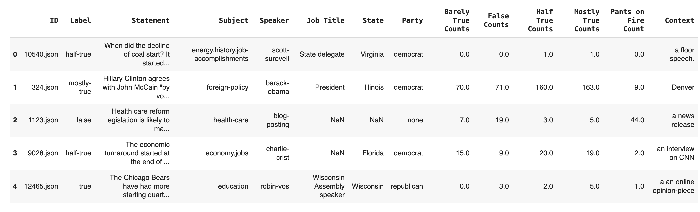

Slide 6
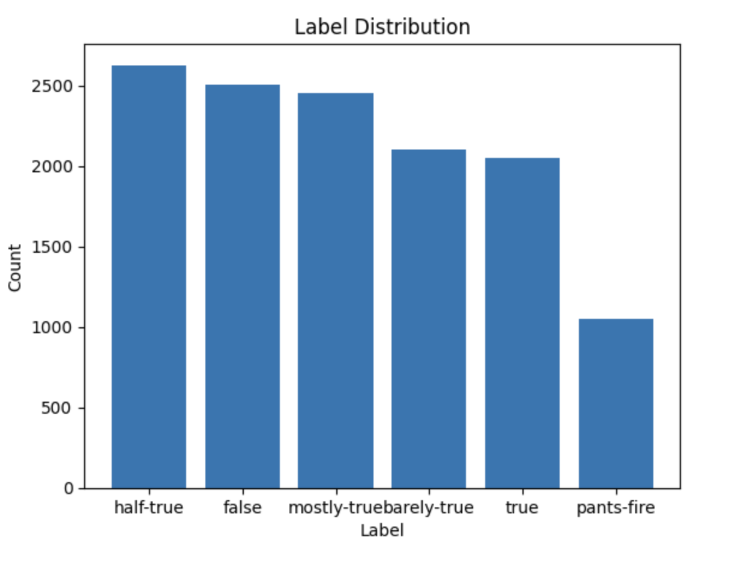
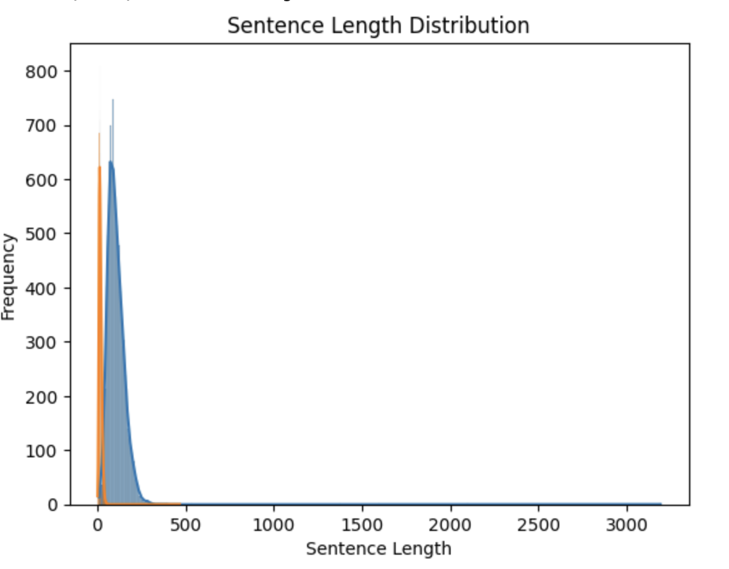
Data Exploratory

Slide 7
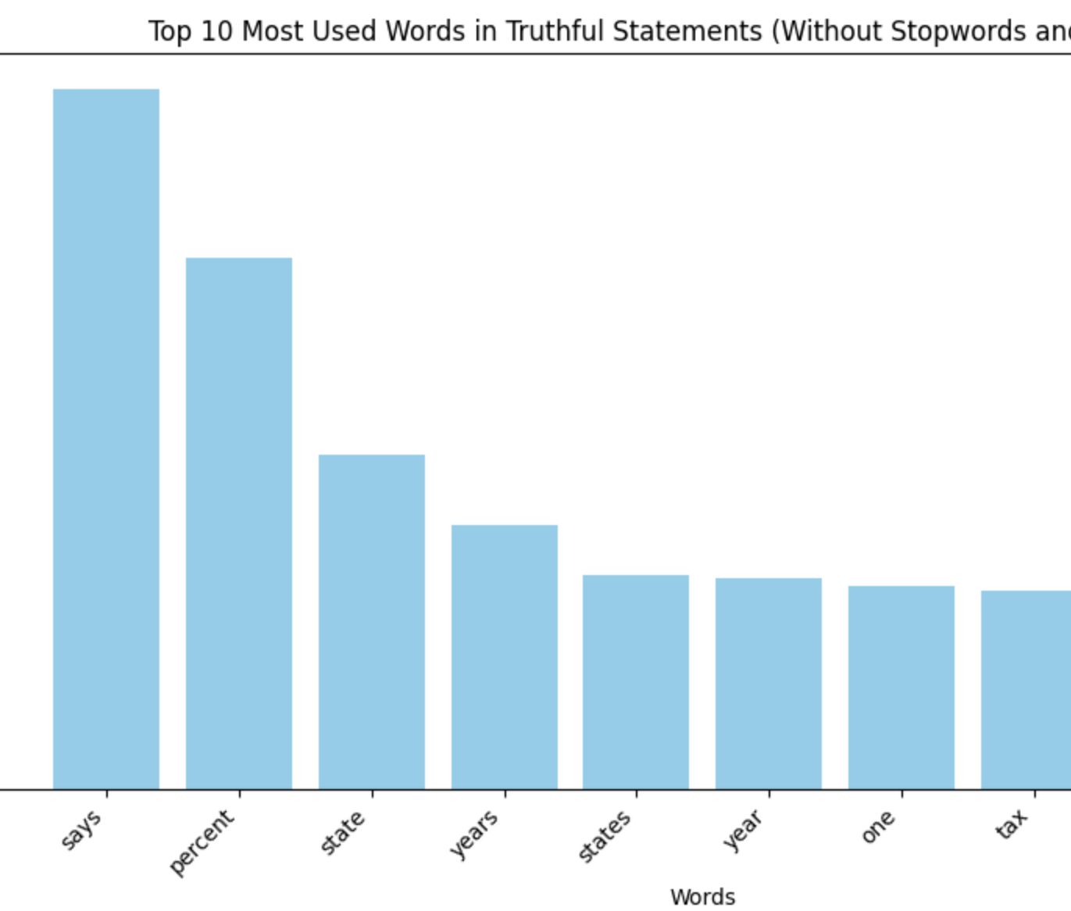
Including True false statements

Slide 8
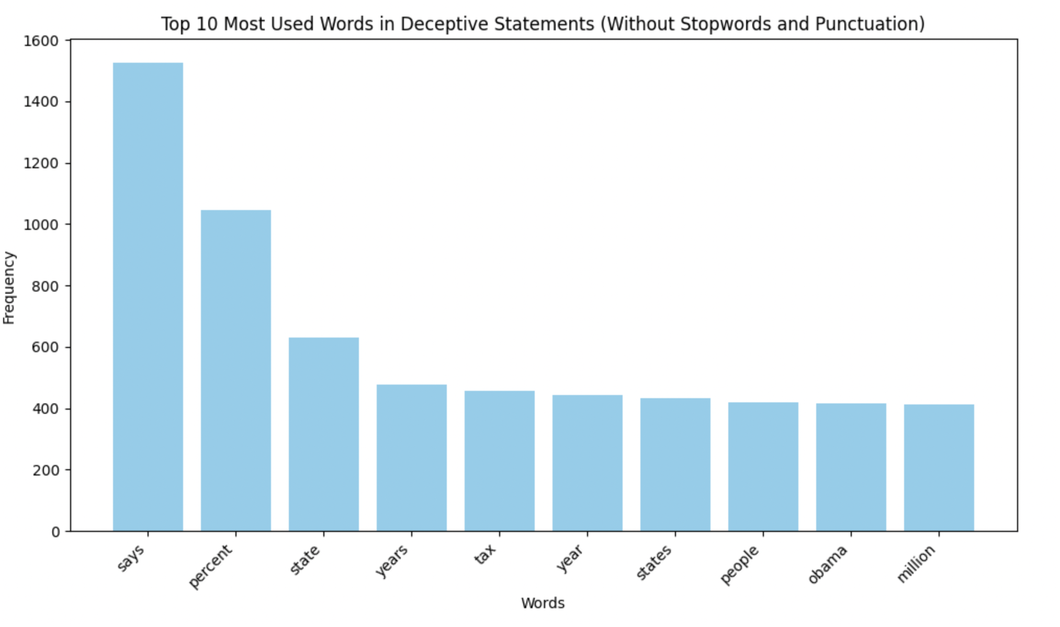
Including true statements, Mostly-true statements and half-true

Slide 9
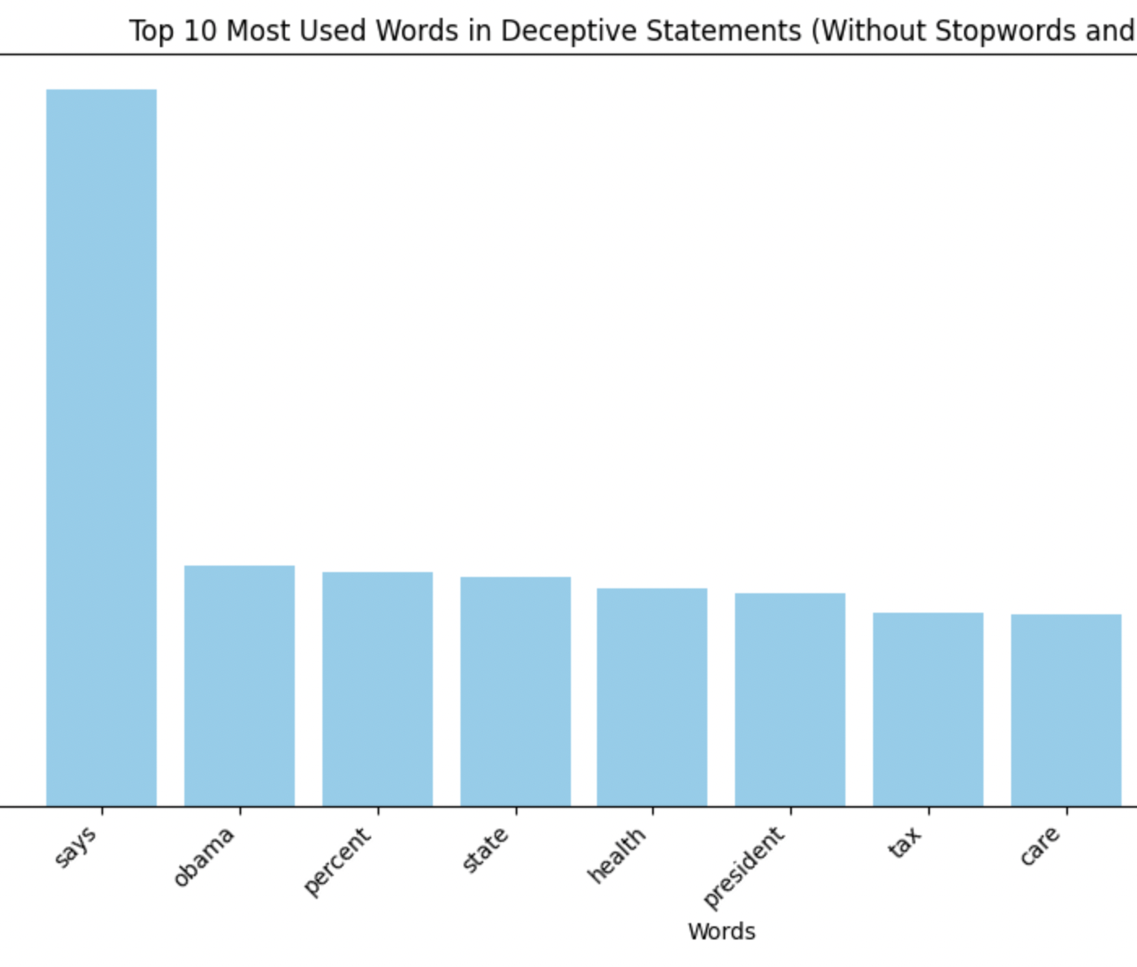
Including only false statements

Slide 10
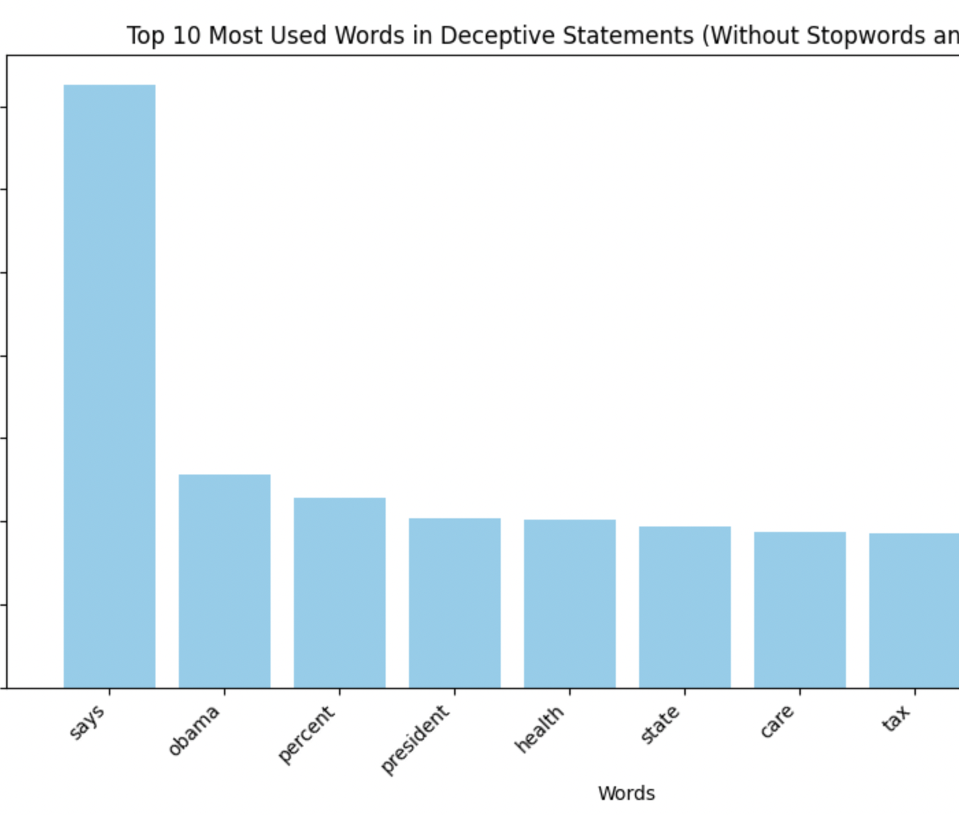
Including false statements, Barely-true statements and pants-fire

Slide 11
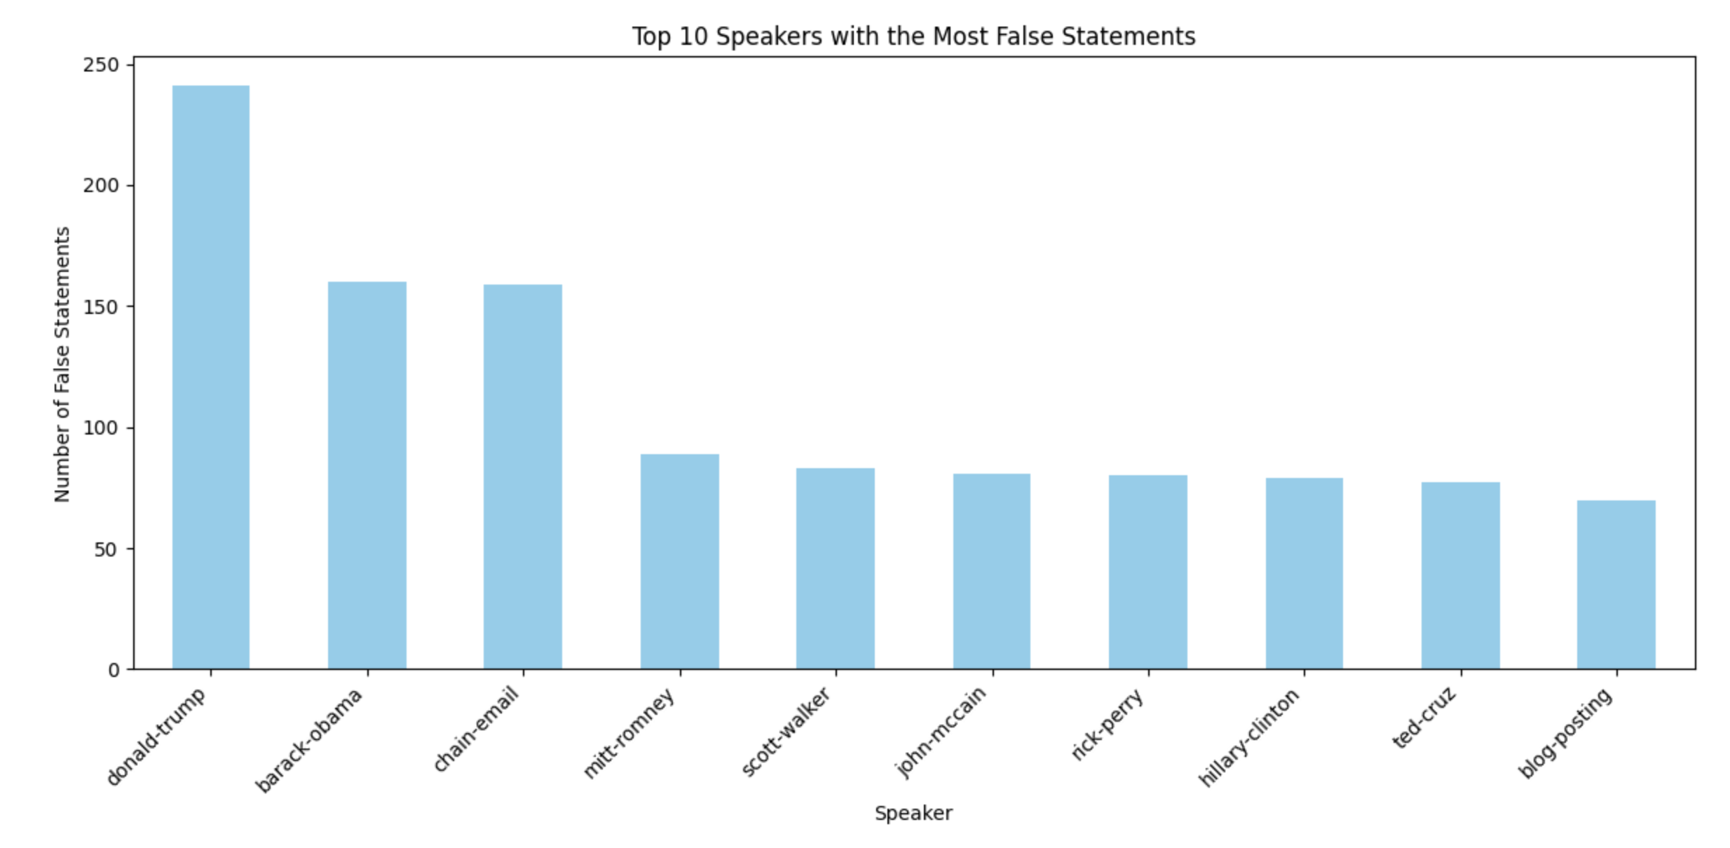

Slide 12
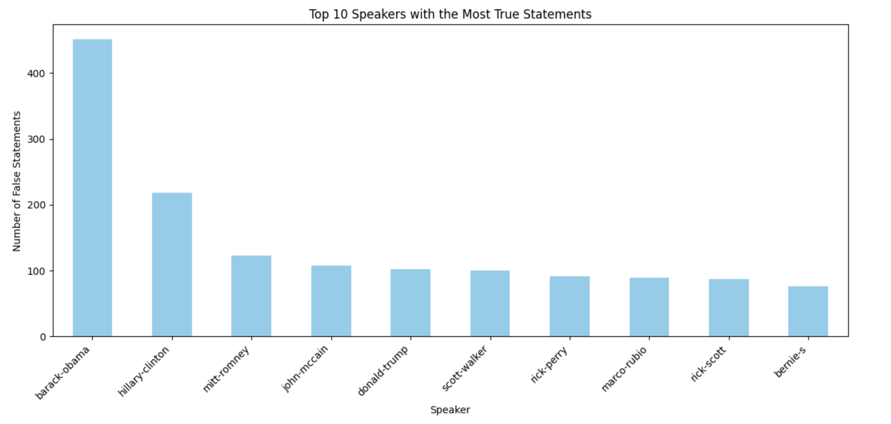

Slide 13
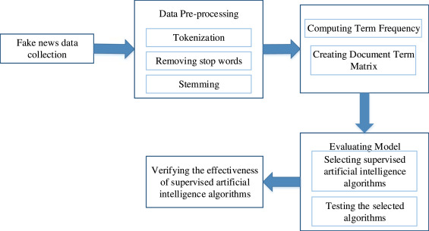

Slide 14
DETECTION
There are 2 ways to detect fake news:
Manual Fake News Detection:
This approach involves human fact checkers and journalists evaluating the content.
It takes more time as it requires human effort and need in-depth research and analysis for each news story.
Automatic Fake News Detection:
By using Machine Learning and Natural Language Processing approaches, different techniques are developed to automate the detection process.

Slide 15
PREPROCESSING ALGORITHMS
These are the algorithms that we used for the project:
TF-IDF vectorization
Bag of Words
N-gram model
Hashing Vectorizer

Slide 16
CLASSIFICATION ALGORITHMS
Random Forest Classifier
Logistic Regression
AdaBoost Classifier
Voting Classifier
XG Boost

Slide 17
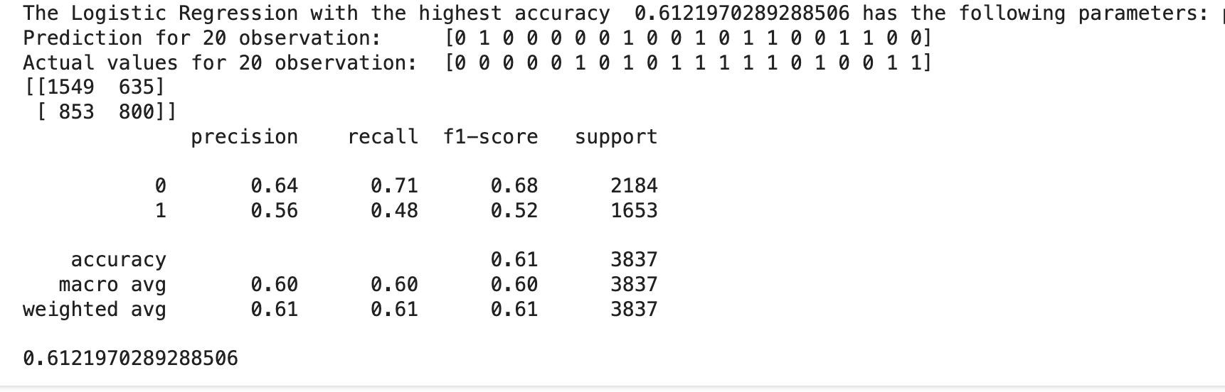
Logistic Regression Classifier

Slide 18
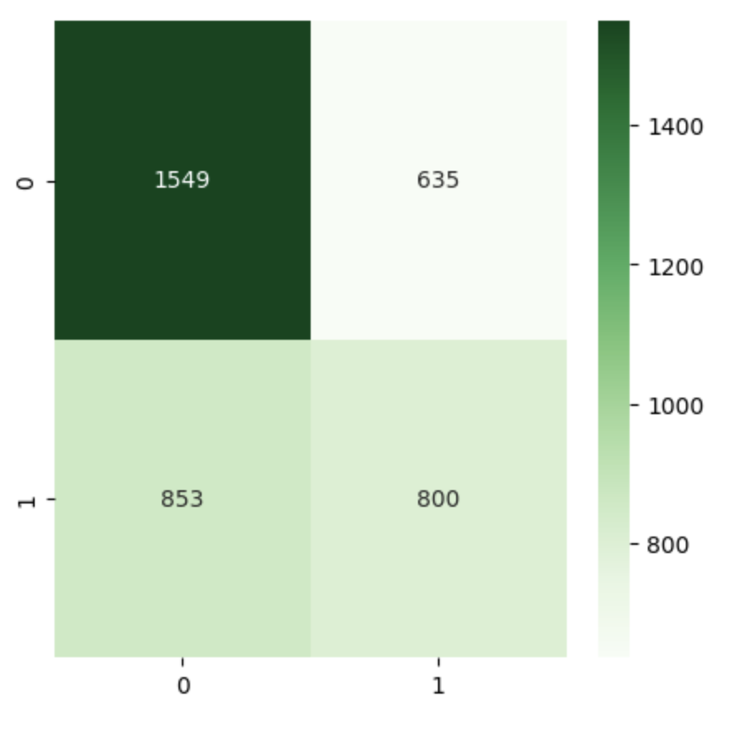

Slide 19
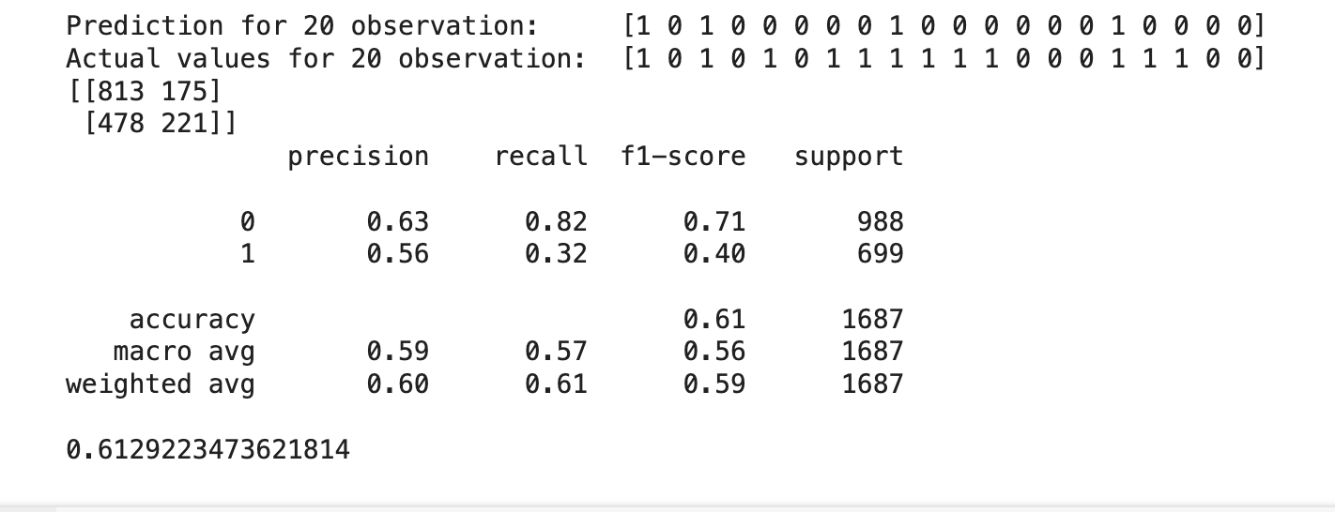
Voting Classifier

Slide 20
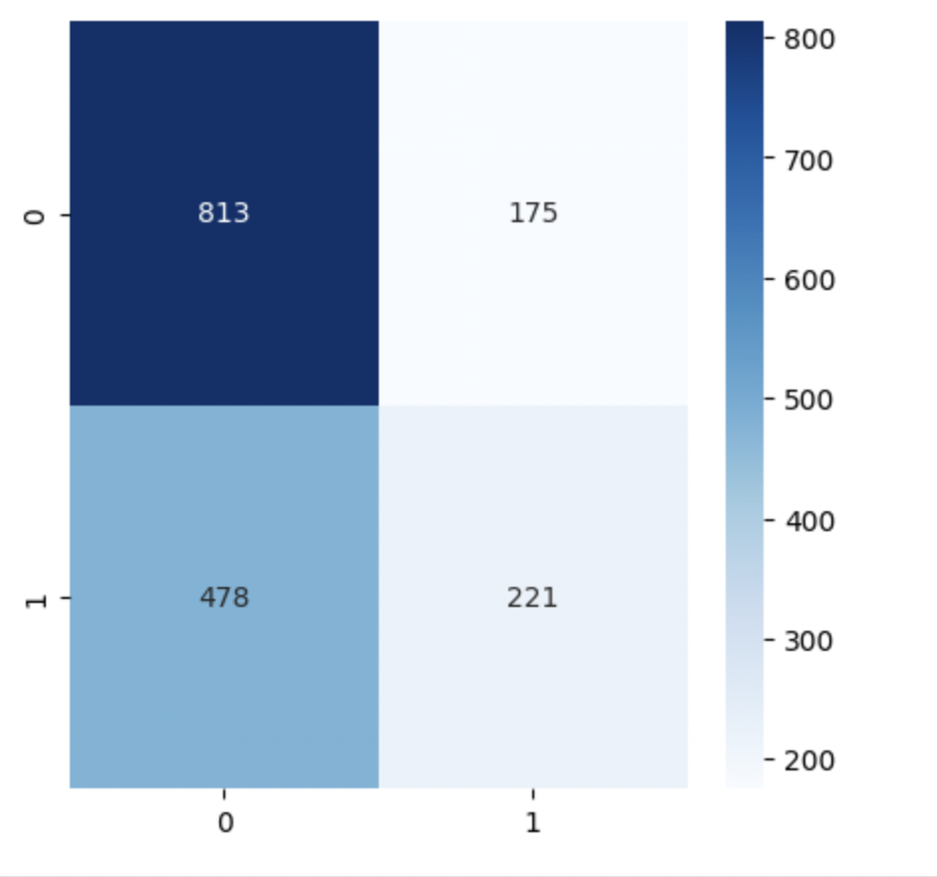

Slide 21
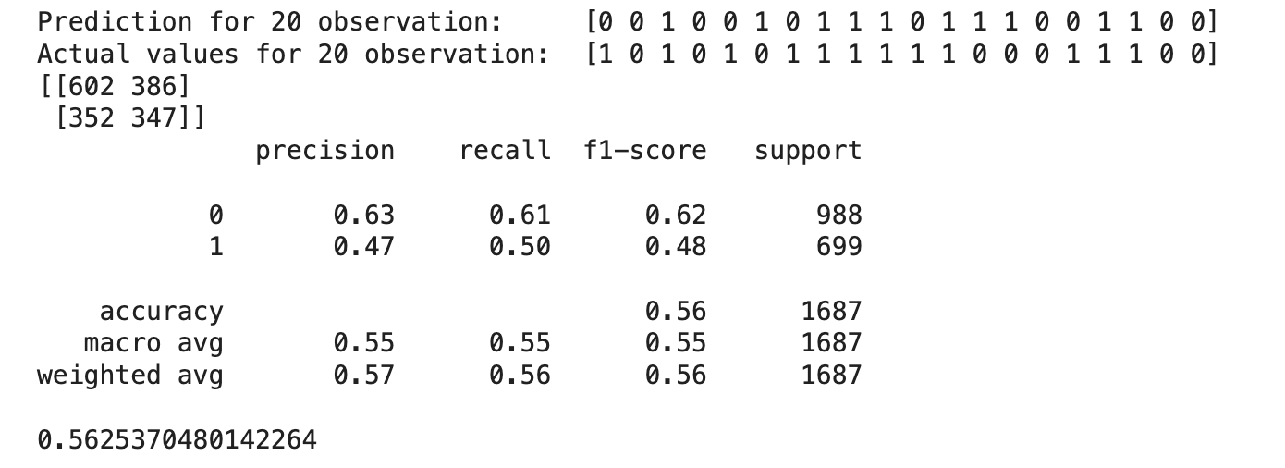
AdaBoost Classifier

Slide 22
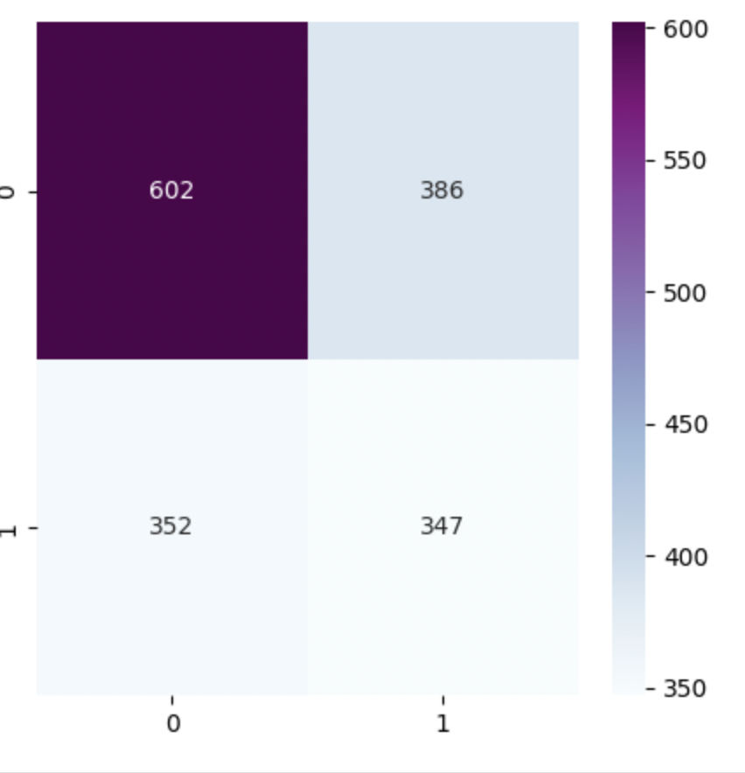

Slide 23
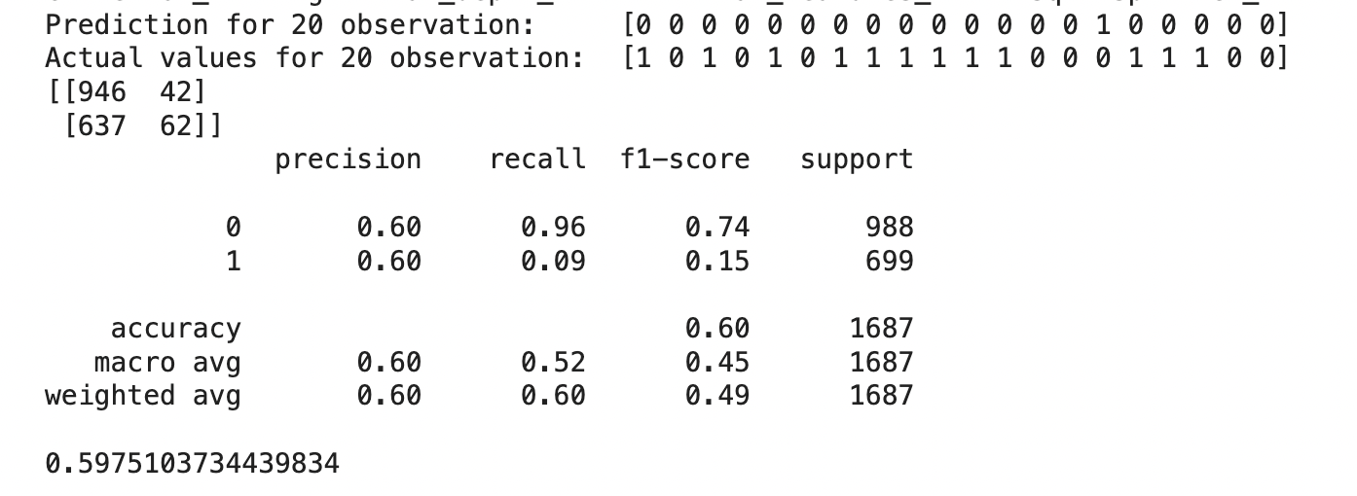
Decision Tree

Slide 24
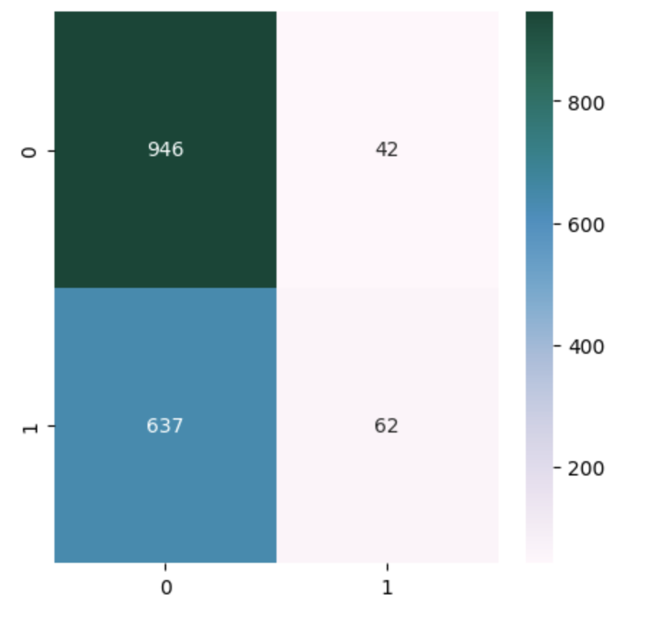

Slide 25
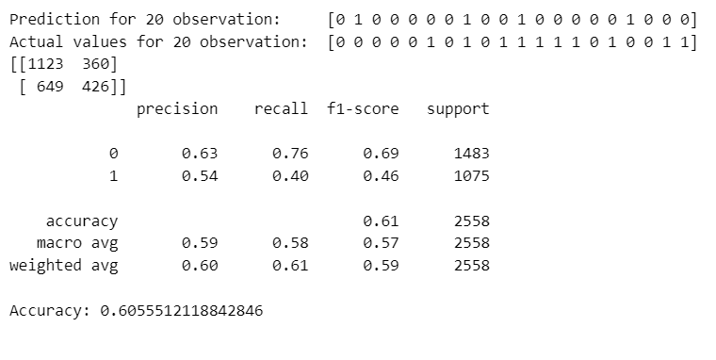
XG BOOST

Slide 26
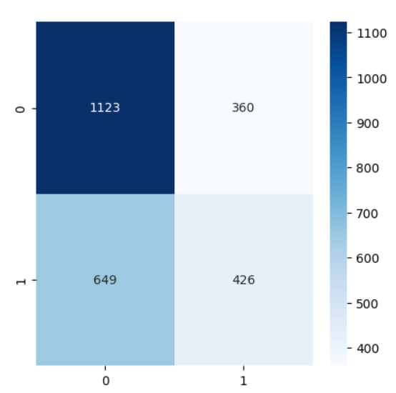

Slide 27
Conclusions
The choice of algorithm can significantly impact the performance of a model on a particular dataset.
XGBoost, being the top performer in this case, suggests that gradient boosting algorithms are well-suited for this dataset.
TF-IDF vectorization likely played a crucial role in providing meaningful features to the algorithms.
Ensemble methods like AdaBoost and Voting Classifier show promise in improving model performance by combining multiple weak learners.

Slide 28
Challenges:
Model Interpretability: Understanding and interpreting decisions made by complex models is challenging but necessary for trust and transparency.
Evaluation Metrics: Selecting appropriate metrics beyond accuracy, such as precision, recall, and F1-score, is essential for comprehensive model evaluation.
Overfitting and Underfitting: Balancing the trade-off between overfitting and underfitting requires careful model selection, tuning, and regularization techniques.
Computational Resources: Training and optimizing complex models may demand significant CPU/GPU power and memory resources, posing computational challenges.
Ethical Considerations: Ensuring fairness, transparency, and accountability in model development and deployment, particularly in sensitive areas like fake news detection, is paramount.

